Slide 1

CheXGPT:
A multimodal reasoning language model for chest X-ray labelling and report generation.
Sai Keertana Devarapalli¹, Mohammed Belal^{3,4}, Abdulla Hourani^{2,4}
English Division; Medical University of Warsaw
Department and clinic of nephrology dialysis and Internal medicine; Medical University of Warsaw.
Physical and Cognitive Intelligence Robotics Lab (PCIR); Khalifa University
Machine Perception Lab; Project Quintessence

Slide 2
Introduction
Large-scale chest X-ray research depends on automated labeling to extract findings from millions of reports. Without it, manual annotation is impossible at scale.
Current State of the art: CheXBert
Our Solution: One Compact Model

Slide 3
Aim of this Study
To develop a single compact multimodal model that
achieves state-of-the-art performance and surpasses CheXbert on CheXpert-style 14-label report classification,
extends supervision to an expanded multi-label taxonomy beyond 14 labels, and
generates image-grounded, label-faithful reports across languages.

Slide 4
Methods
We benchmarked many open-source LLMs (Qwen, Llama, Gemma, Phi, GPT-OSS) on CheXpert, MIMIC-CXR, ReXGradient-160K, PadChest (Spanish), and CASIA-CXR (French) using a unified prompt and CheXpert-compatible output schema.
We ablated zero-shot, few-shot, and dynamic few-shot retrieval (pool=50), and evaluated quantized inference (INT4/INT8).
We then fine-tuned and post-trained Qwen3-V-4B on ~1.3M radiology reports and ~450k CXR images with mixed objectives: supervised multi-label classification (CheXpert-14 plus additional labels) and instruction-style image-to-report generation, including multilingual training.
Performance was evaluated on held-out test sets; 95% confidence intervals were obtained by bootstrapping.

Slide 5
Methods: T1. Study datasets and task overview
Dataset | Language | Task(s) | Total reports | Total Images | Train (N) | Test (N) | Sex (% female) | Age
CheXpert | English | 1. Classification | 187,711 | 223,228 | 154,510 | 500 | 46.50% | 58.1 ± 14.0
 |  | 2. Report Generation
MIMIC-CXR | English | 1. Classification | 227,835 | 377,110 | 198,512 | 500 | 51.80% | 53.7 ± 19.0
 |  | 2. Report Generation
ReXGradient-160K | English | 1. Classification | 160,000 | 273,004 | 115,183 | 500 | 49.70% | 49.8 ± 21.2
 |  | 2. Report Generation
PadChest | Spanish | 1. Classification | 109,931 | 160,868 | 97,466 | 500 | 50.10% | 57.8 ± 16.5
 |  | 2. Report Generation
 |  | 3. Language Bridging
 |  | 4. VQA
CASIA-CXR | French | 1. Classification | 11,111 | 11,111 | 9,182 | 500 | 45.80% | -
 |  | 2. Report Generation
 |  | 3. Language Bridging
 |  | 4. VQA
NIH-14 | English | 1. Report Generation | 82,522 | 112,120 | 82,522 | - | 43.50% | 46.8 ± 16.6
Synthetic | English | 1. Classification | 709,713 | 235,215 | 709,713 | - | - | -
 | Spanish | 2. Report Generation
 | French | 3. Language Bridging
 |  | 4. VQA
VINDR-CXR | English | 1. VQA | 1000 | 1000 | - | 1000 | - | -

Slide 6
Methods: T2. Models benchmarked and evaluation setup by task
Model | Model type | Tasks evaluated in this study | Prompt setting(s) evaluated | Role in study
BioMistral-7B | Text-only biomedical LLM | Classification | Zero-shot; few-shot; dynamic few-shot retrieval | Biomedical text baseline
CheXbert | Task-specific text classifier | Classification only | None (fixed baseline) | SOTA
GPT-OSS-20B | Text-only Reasoning LLM | Classification | Zero-shot; few-shot; dynamic few-shot retrieval | Reasoning LLM baseline
Llama 3.1-8B | Text-only general LLM | Classification | Zero-shot; few-shot; dynamic few-shot retrieval | General LLM baseline
MedGemma-27B | Multimodal medical LLM | Classification; Report Generation; VQA | Zero-shot; few-shot; dynamic few-shot retrieval | Medical multimodal baseline
MedGemma-4B | Multimodal medical LLM | Classification; Report Generation; VQA | Zero-shot; few-shot | Medical multimodal baseline
MediPhi | Text-only medical LLM | Classification | Zero-shot; few-shot; dynamic few-shot retrieval | Biomedical text baseline
Qwen3-VL-4B- Instruct | Multimodal -language model | Classification; Report Generation; VQA | Zero-shot; few-shot; dynamic few-shot retrieval | Multimodal LLM baseline
Qwen3-VL-4B- Thinking | Multimodal -language reasoning model | Classification; Report Generation; VQA | Zero-shot; few-shot; dynamic few-shot retrieval | Multimodal reasoning LLM baseline
CheXGPT (ours) | Post-trained multimodal medical model | Classification; Report Generation; VQA; Language Bridging | Zero-shot; task-tuned prompting | Final proposed model

Slide 7
Results:
T3. Main CheXpert-style 14-label classification benchmark across evaluated models
Model | Best Macro F1 (95% CI) | Median Macro F1 (IQR) | Delta vs CheXbert (Best) | Runs Above CheXbert
BioMistral-7B | 0.459 (0.423, 0.491) | 0.368 (0.235, 0.415) | -0.29 | 0
CheXbert | 0.749 (0.729, 0.764) | 0.749 (0.749, 0.749) | 0.00 | 0
GPT-OSS-20B | 0.835 (0.817, 0.851) | 0.818 (0.808, 0.829) | 0.086 | 12
Llama-3.1-8B-Instruct | 0.758 (0.723, 0.785) | 0.722 (0.704, 0.733) | 0.009 | 0
MedGemma-27B | 0.795 (0.778, 0.810) | 0.782 (0.777, 0.788) | 0.046 | 12
MedGemma-4B | 0.707 (0.669, 0.736) | 0.697 (0.676, 0.701) | -0.042 | 0
MediPhi-Instruct | 0.643 (0.602, 0.678) | 0.582 (0.572, 0.590) | -0.106 | 0
Qwen3-VL-4B-Thinking | 0.859 (0.830, 0.884) | 0.808 (0.800, 0.814) | 0.11 | 12
Qwen3-VL-4B-Instruct | 0.753 (0.733, 0.768) | 0.748 (0.740, 0.750) | 0.004 | 1
CheXGPT (ours) | 0.930 (0.910, 0.950) |  | 0.157

Slide 8
Results: T4. Best-configuration performance of CheXGPT versus strongest baseline models on the held-out CheXpert-style classification benchmark
Model | Model category | Best prompt / configuration | k-shot | Precision (95% CI) | Recall (95% CI) | Macro-F1 (95% CI) | Δ vs CheXbert | Δ vs best baseline | FDR-adjusted p
CheXGPT (ours) | Post-trained multimodal medical model | task-tuned prompting | - | 0.950 (0.930–0.970) | 0.910 (0.890–0.930) | 0.930 (0.910–0.950) | 0.181 | 0.095 | <0.001
GPT-OSS-20B | Best prompted text baseline | clinical-stepwise | 0 | 0.864 (0.844–0.881) | 0.820 (0.800–0.839) | 0.835 (0.817–0.851) | 0.086 | 0 | 0.003
MedGemma-27B | Best prompted multimodal medical baseline | clinical-compact | 5 | 0.743 (0.723–0.764) | 0.873 (0.856–0.890) | 0.795 (0.778–0.810) | 0.046 | -0.04 | 0.003
Qwen3-VL-4B-Instruct | Best prompted lightweight baseline in paired comparison | clinical-compact | 5 | 0.767 (0.748–0.786) | 0.754 (0.728–0.775) | 0.753 (0.733–0.768) | 0.004 | -0.082 | 0.739
CheXbert | Fixed baseline | none | – | 0.710 (0.689–0.730) | 0.843 (0.824–0.858) | 0.749 (0.729–0.764) | 0 | -0.086 | 1

Slide 9
Results:

Slide 10
Report 1 | source dataset: indiana | example ID: 1102 | status: exact
PROBLEMS: Cardiomegaly;Pulmonary Congestion;Pulmonary Edema;Pleural Effusion;Airspace Disease
INDICATION: Shortness of breath. Unable to XXXX XXXX for lateral view.
IMPRESSION: There is stable cardiomegaly with XXXX pulmonary vascular congestion and probable mild interstitial edema. There are bilateral pleural effusions with bibasilar airspace disease, right greater than left. There is no pneumothorax. There are no acute bony findings.
Label | Truth | CHEXGPT
no_finding | 0 | 0
enlarged_cardiomediastinum | null | null
cardiomegaly | 1 | 1
lung_opacity | 1 | 1
lung_lesion | null | null
edema | 1 | 1
consolidation | null | null
pneumonia | null | null
atelectasis | null | null
pneumothorax | 0 | 0
pleural_effusion | 1 | 1
pleural_other | null | null
fracture | 0 | 0
support_devices | null | null

Slide 11
Report 2 | source dataset: indiana | example ID: 2414 | status: exact
PROBLEMS: Technical Quality of Image Unsatisfactory ;Scoliosis;Cardiomegaly;Spinal Fusion;Lung;Diaphragm;Airspace Disease;Pulmonary Atelectasis
INDICATION: Hypoxemia
IMPRESSION: Again, the patient is mildly rotated, and there is a mild XXXX curvature of the thoracic spine. Stable borderline cardiac enlargement. In the left lower lobe on the lateral view, there appears to be some patchy airspace disease which is probably mostly atelectasis from an elevated left diaphragm. The be difficult to completely exclude a superimposed pneumonia. No significant pleural effusion or pneumothorax. There is an extensive fusion of the posterior cervical spine
Label | Truth | CHEXGPT
no_finding | 0 | 0
enlarged_cardiomediastinum | null | null
cardiomegaly | -1 | -1
lung_opacity | 1 | 1
lung_lesion | null | null
edema | null | null
consolidation | null | null
pneumonia | -1 | -1
atelectasis | 1 | 1
pneumothorax | 0 | 0
pleural_effusion | 0 | 0
pleural_other | null | null
fracture | null | null
support_devices | null | null

Slide 12
Report 3 | source dataset: rexgradient | status: error
INDICATION: Dizziness. Near syncope.
COMPARISON: None.
Findings: Blunting of the left costophrenic angle is compatible with a tiny effusion. Lungs are clear. Heart size is normal. Tortuous aorta is noted.
Impression: Tiny left pleural effusion. Otherwise negative.
Label | Truth | CHEXGPT
no_finding | 0 | 0
enlarged_cardiomediastinum | 0 | 0
cardiomegaly | 0 | 0
lung_opacity | 0 | 0
lung_lesion | 0 | 0
edema | 0 | 0
consolidation | 0 | 0
pneumonia | 0 | 0
atelectasis | 0 | 0
pneumothorax | 0 | 0
pleural_effusion | 1 | 1
pleural_other | 1 | 0
fracture | 0 | 0
support_devices | 0 | 0

Slide 13
Report 4 | source dataset: rexgradient | status: error
INDICATION: Left shoulder pain
COMPARISON: None.
Findings: Chronic interstitial markings. Mild bilateral lower lobe scarring/atelectasis. No pleural effusion or pneumothorax. The heart is normal in size. Degenerative changes of the visualized thoracolumbar spine. Cholecystectomy clips.
Impression: No evidence of acute cardiopulmonary disease.
Label | Truth | CHEXGPT
no_finding | 0 | 1
enlarged_cardiomediastinum | 0 | 0
cardiomegaly | 0 | 0
lung_opacity | 0 | 0
lung_lesion | 0 | 0
edema | 0 | 0
consolidation | 0 | 0
pneumonia | 0 | 0
atelectasis | 1 | 0
pneumothorax | 0 | 0
pleural_effusion | 0 | 0
pleural_other | 0 | 0
fracture | 0 | 0
support_devices | 0 | 0

Slide 14
Results: Table 5. Quantization and efficiency trade-offs
Model Name | Macro F1 | Macro F1 - FP16 | Macro F1 - CheXbert | FP16 RPM | INT4 RPM | Delta RPM | Speedup (x) | Delta repair rate
MedGemma-27B int4 | k=0 | clinical-compact | 0.779 | 0.005 | 0.031 | 341.27 | 489.88 | 148.6 | 1.44 | 0.00
MedGemma-27B int4 | k=0 | clinical-stepwise | 0.771 | 0.005 | 0.022 | 340.18 | 485.68 | 145.5 | 1.43 | 0.00
MedGemma-27B int4 | k=5 | clinical-compact | 0.789 | -0.006 | 0.04 | 125.72 | 162.2 | 36.48 | 1.29 | 0.00
MedGemma-27B int4 | k=5 | clinical-stepwise | 0.784 | -0.002 | 0.035 | 125.51 | 162.08 | 36.57 | 1.29 | 0.00
Qwen3-4B int4 | k=0 | clinical-compact | 0.694 | -0.027 | -0.054 | 1163.69 | 1618.38 | 454.69 | 1.39 | 0.00
Qwen3-4B int4 | k=0 | clinical-stepwise | 0.697 | -0.049 | -0.052 | 844.7 | 2040.38 | 1195.68 | 2.42 | 0.00
Qwen3-4B int4 | k=5 | clinical-compact | 0.741 | -0.012 | -0.008 | 551.36 | 868.3 | 316.94 | 1.57 | 0.00
Qwen3-4B int4 | k=5 | clinical-stepwise | 0.728 | -0.021 | -0.021 | 545.8 | 859.61 | 313.81 | 1.57 | 0.00
CheXGPT int4 | k=0 | clinical-compact | 0.89 | –0.040 | 0.142 | 1382.5 | 1935.5 | 553 | 1.40 | 0.00
CheXGPT int2 | k=0 | clinical-compact | 0.84 | –0.090 | 0.092 | 1382.5 | 2488.5 | 1106 | 1.80 | 0.00

Slide 15
Results:

Slide 16
Results: T6. Report generation
Model | BLEU | ROUGE-L | BERTScore | Label-faithfulness / label similarity Macro-F1 | Hallucination rate | Multilingual generation support
Lingshu-I-8B | 0.21 | 0.285 | 0.5 | 0.8 | 12 | Yes
MAIRA-2 | 0.2 | 0.34 | 0.9 | 0.79 | 0.12 | No
MedGemma-1.5-4B | 0.18 | 0.31 | 0.89 | 0.76 | 0.14 | Yes
MedGemma-27B | 0.16 | 0.29 | 0.88 | 0.74 | 0.16 | Yes
Qwen3-VL-4B-Instruct | 0.11 | 0.27 | 0.72 | 0.72 | 0.15 | Yes
Qwen3-VL-4B-Thinking | 0.18 | 0.31 | 0.89 | 0.77 | 0.13 | Yes
CheXGPT | 0.24 | 0.38 | 0.91 | 0.86 | 0.08 | Yes

Slide 17
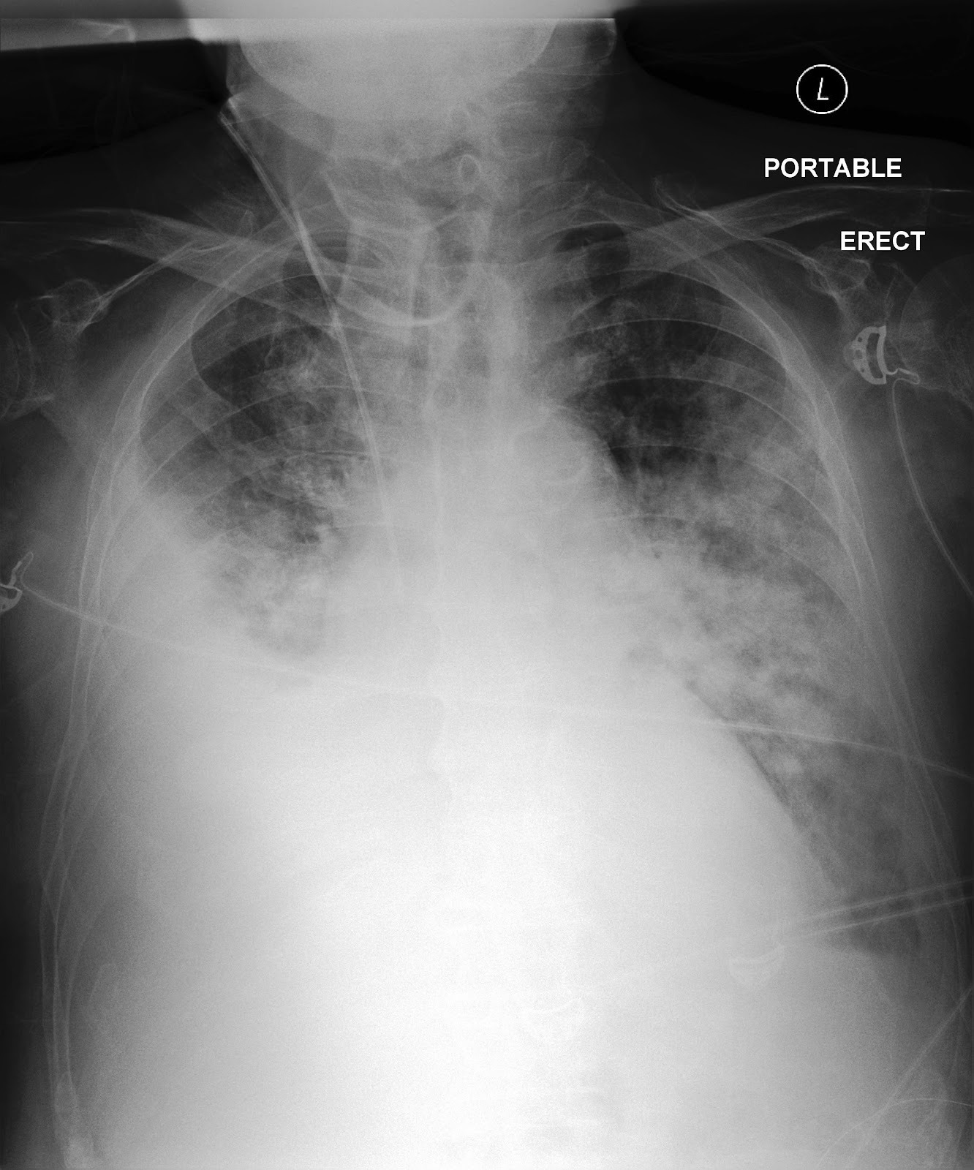
Results: Report generation
 | WET READ: FINAL REPORT AP CHEST, 6:34 P.M. HISTORY: Aortic stenosis. CHF. Confusion. IMPRESSION: AP chest compared to ___ through ___: Large right pleural effusion has remained stable since ___. There is extensive new opacification in the left lung in a generally perihilar distribution, most readily explained by pulmonary edema though pulmonary hemorrhage and pneumonia could be contributory. Heart is enlarged, but hard to assess because of adjacent right pleural effusion. Right jugular line ends in the mid SVC. No pneumothorax. | GENERATED: Findings: Portable AP erect chest radiograph obtained. Right internal jugular central venous catheter tip projects in expected position over the mid SVC. Cardiomediastinal silhouette is enlarged, although partially obscured inferiorly by adjacent pleural/parenchymal opacity. Large right pleural effusion is present, with a small left pleural effusion. Extensive bilateral patchy-to-confluent airspace opacities are seen, greatest in the left perihilar/mid-lower lung and in the right perihilar/right basilar lung. Associated dense right basilar veiling opacity is present, likely reflecting compressive atelectatic change adjacent to the pleural effusion. No pneumothorax. Impression: Large right pleural effusion and small left pleural effusion. Extensive new bilateral airspace opacities, greatest in the left perihilar/mid-lower lung, favored to represent pulmonary edema in the setting of cardiomegaly/CHF. Adjacent right basilar compressive atelectatic change. Superimposed pneumonia, and less likely pulmonary hemorrhage depending on the clinical setting, cannot be excluded. Right internal jugular central venous catheter terminates in the mid SVC. No pneumothorax.

Slide 18
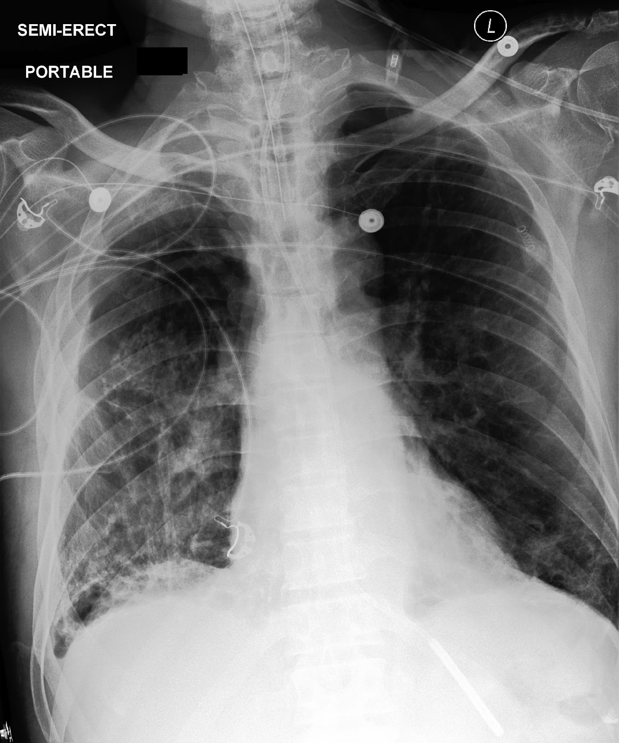
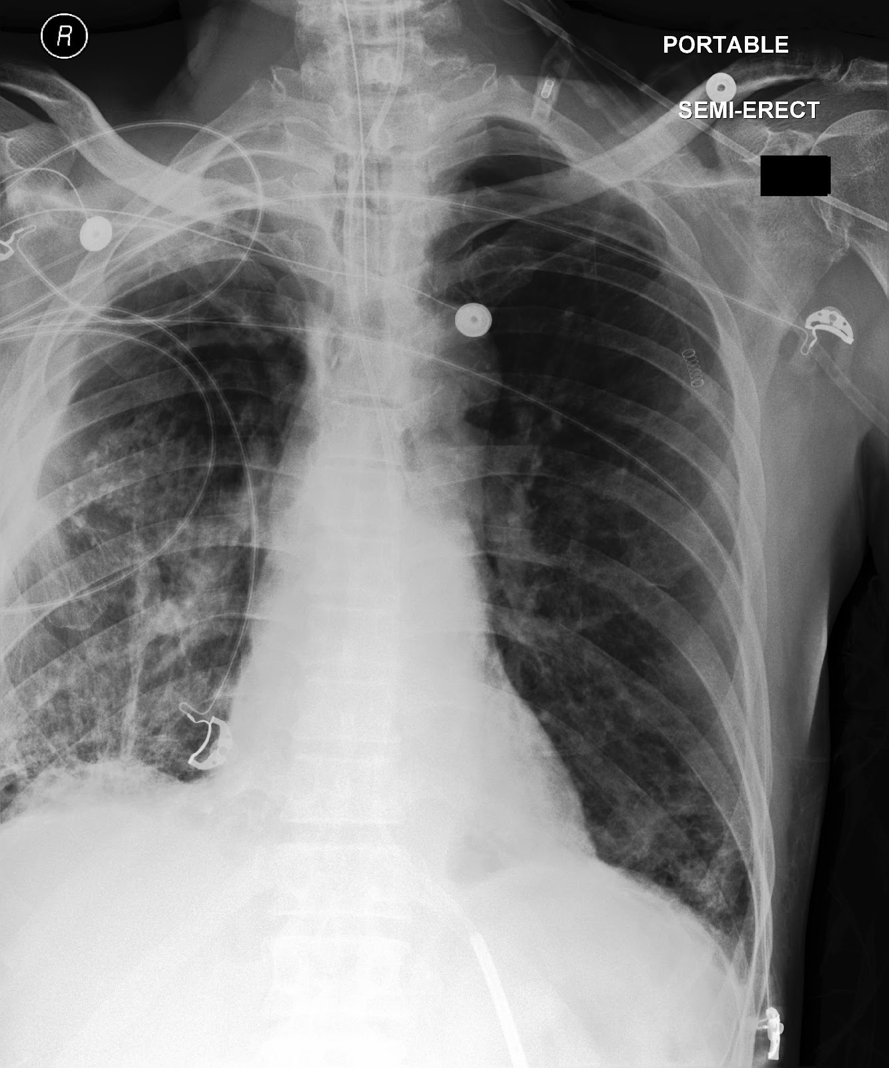
Results: Report generation - SPANISH
 | WET READ: FINAL REPORT AP CHEST, 4:34 A.M. HISTORY: Craniotomy. Diabetes insipidus and pulmonary edema. IMPRESSION: AP chest compared to ___: Extensive infiltrative pulmonary abnormality in the right lower lobe, and overlying pleural calcification are longstanding, but previous pulmonary edema in this location has improved if not resolved, leaving behind a small residual right pleural effusion. The left lung base was relatively clear on ___ and also developed some edema, which has decreased since ___. Given the severe scarring in these lungs, some pneumonia could be present and not appreciated, for example, just projecting over the right hilus, but in the left lung, there is no evidence of pneumonia. ET tube is in standard placement. Feeding tube ends in the upper stomach. The heart is not enlarged. Right pleural thickening is most extensive at the apex and unchanged. No pneumothorax. | GENERATED: Hallazgos: Radiografía portátil de tórax AP en posición semierguida. El tubo endotraqueal tiene la punta en posición esperada dentro de la tráquea torácica, por encima de la carina. La sonda enteral/de alimentación desciende por debajo del diafragma, con la punta distal proyectándose sobre la porción superior del estómago/región gástrica proximal. La silueta cardiomediastínica no está aumentada de tamaño. Se observa una anormalidad pleuropulmonar crónica derecha con engrosamiento pleural y cambios pleurales calcificados/cicatriciales, más marcados en el ápex derecho y en el hemitórax superior lateral derecho. Persisten opacidades intersticiales/alveolares gruesas, parcheadas a confluentes, en el pulmón derecho medio e inferior, predominando en la base derecha, con opacidad parcheada más leve en la base pulmonar izquierda. Hay un pequeño derrame pleural residual derecho. No hay neumotórax. Impresión: 1. Cambios cicatriciales pleuroparenquimatosos crónicos del hemitórax derecho con engrosamiento pleural y cambios pleurales calcificados, más pronunciados en el ápex derecho. 2. Opacidades intersticiales/alveolares persistentes, de predominio bibasal y mayores en el lado derecho, favoreciendo edema pulmonar residual superpuesto a cambios cicatriciales crónicos, sin cardiomegalia marcada. 3. Pequeño derrame pleural residual derecho. 4. No puede excluirse con certeza una neumonía sobreañadida, especialmente en la región perihiliar derecha/lóbulo inferior derecho, debido a la extensa alteración pulmonar crónica subyacente; no hay evidencia convincente de neumonía focal en el pulmón izquierdo. 5. Tubo endotraqueal en posición satisfactoria. La sonda enteral termina en la porción superior del estómago. No hay neumotórax.

Slide 19
Results: T7. Visual Question Answering (VQA)
Model | Accuracy (95% CI) | Macro-F1 (95% CI)
CheXGPT | 0.83 (0.79–0.86) | 0.81 (0.77–0.85)
Qwen3-VL-4B-Thinking | 0.74 (0.70–0.78) | 0.72 (0.68–0.76)
MedGemma-27B | 0.72 (0.68–0.76) | 0.70 (0.66–0.74)
Qwen3-VL-4B-Instruct | 0.69 (0.65–0.73) | 0.67 (0.63–0.71)
MedGemma-4B | 0.65 (0.60-0.68) | 0.62 (0.58-0.66)

Slide 20
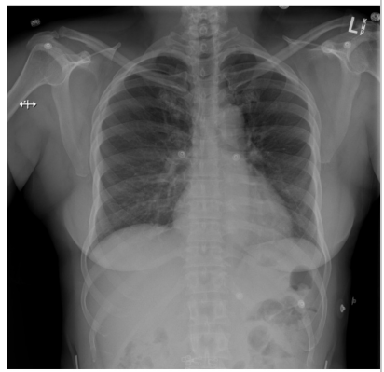
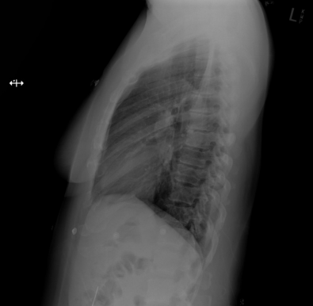
Results: Visual Question Answering (VQA) examples
 | Model Input (Prompt) Question 1: ”How would you describe the cardiac silhouette on this chest radiograph?” Options: "A": "There is enlargement of the heart", "B": "Cardiac size appears normal", "C": "There is evidence of fluid around the heart", "D": "The heart appears smaller than expected" | CheXGPT Response Answer: ”B”
 |  | Reasoning: "To answer this, the cardiac silhouette should be assessed in relation to the thoracic cavity and the surrounding mediastinal contours. On this chest X-ray, the heart does not appear enlarged, and its overall shape remains proportionate without abnormal widening or globular configuration. There are also no visible features to suggest fluid accumulation around the heart, such as a markedly altered or distended cardiac contour. In addition, the appearance is not consistent with an abnormally small cardiac silhouette. Taking these findings together, the most appropriate conclusion is that the heart size is within the expected normal range."

Slide 21
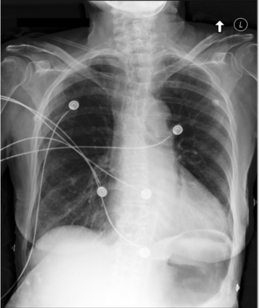
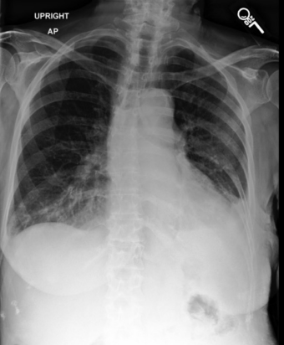
Results: Visual Question Answering (VQA) examples
 | Model Input (Prompt) Question 2: ”You are shown a prior reference image and a follow-up image. What is the interval change in pleural effusion?” Options: "A": "Resolving", "B": "Progressing", "C": "Unchanged" | CheXGPT Response Answer: ”B”
 |  | Reasoning: "This question requires a direct comparison between the earlier chest X-ray and the newer one, focusing specifically on pleural fluid. In the reference image, there is no significant pleural effusion identified on either side. On the follow-up image, however, a left pleural effusion is present and is more conspicuous than before. That means the amount of pleural fluid has increased rather than decreased or remained the same. Since the interval change reflects an increase in effusion burden, the pleural effusion is best described as worsening over time."

Slide 22
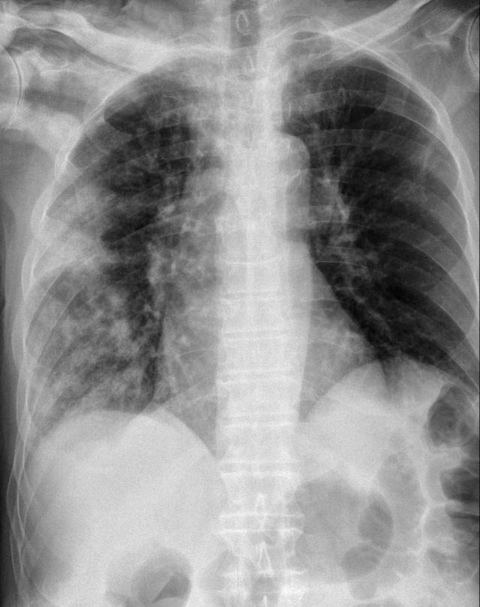
Results: Visual Question Answering (VQA) examples
 | Model Input (Prompt) Question 1: "Quelle pathologie est présente sur cette radiographie thoracique ?" Options: "A": "Pneumonie", "B": "Atélectasie", "C": "Cardiomégalie", "D": "BPCO” | CheXGPT Response Answer: ”A”
 |  | Reasoning: "La radiographie thoracique montre de multiples opacités alvéolaires prédominant dans l’hémichamp pulmonaire droit, avec une distribution surtout périphérique, associées à quelques opacités micronodulaires et nodulaires aux contours flous. Le compte-rendu radiologique précise également une atteinte pulmonaire alvéolaire droite d’origine probablement infectieuse. Cet ensemble d’arguments oriente avant tout vers une pneumonie, car une infection parenchymateuse pulmonaire se manifeste classiquement par des opacités alvéolaires focales ou multifocales de ce type. L’option atélectasie est moins probable, car on ne décrit pas ici de signes dominants de perte de volume pulmonaire, de déplacement médiastinal ou de rétraction lobaire nette. La cardiomégalie n’est pas retenue, puisque la silhouette cardiaque est explicitement décrite comme normale. La BPCO n’est pas le meilleur choix non plus, car l’image n’est pas dominée par une hyperinflation diffuse, un aplatissement diaphragmatique marqué ou d’autres signes typiques d’emphysème. Ainsi, la présentation radiographique et le compte-rendu du radiologue soutiennent clairement le diagnostic de pneumonie."

Slide 23
Discussion
Main Findings
After fine-tuning Qwen3-V-4B, CheXGPT achieved a Macro-F1 of 0.93 (0.91–0.95) on the 14-label CheXpert benchmark. This is higher than the CheXbert’s baseline of 0.749 (0.729–0.764).
For generated reports, label similarity to gold labels reached macro-F1 0.86 (0.84–0.88) with BLEU 0.24, indicating improved label faithfulness.
The Value of Dynamic Few-Shot Retrieval - Lung Lesion and Pleural Other
INT4 quantization preserved over 95% of the model's F1 performance while cutting inference latency by nearly half.
Qualitative Strengths: VQA and Multilingual report generation

Slide 24
Conclusions
A post-trained 4B multimodal LLM can unify CheXpert-style labeling and multilingual, image-grounded report generation, providing a practical, efficient alternative to CheXbert with tunable prompt- and hardware-level trade-offs.

Slide 25
Thank you!

