Slide 1

From Risk Scores to Agents: What “AI” Really Means in Nephrology
AI through the eyes of a young nephrologist
Abdulla Hourani
MD, ML engineer, PhD candidate
Department and Clinic of Nephrology Dialysis and Internal Medicine

Slide 2
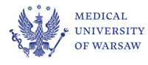
Objectives
- Clarify what “AI” means and pinpoint common uses in Nephrology
- ML & DL: Common applications.
- Large language models.
- Understand what “agents” add beyond chat.

Slide 3
AI is a toolbox, not a magic box nor new
?
Artificial Narrow Intelligence
ANI
Artificial General Intelligence
AGI
Artificial Super Intelligence
ASI
Est. 2027*
1950-today
* www.ai-2027.com

Slide 4
AI is a toolbox, not a magic box nor new
AI
ML
DL
LLM
Agents

Slide 5
Machine Learning
ML
Risk prediction
Trajectory modelling
Causal analyses
Pharmacokinetics
Prognostic outcome

Slide 6
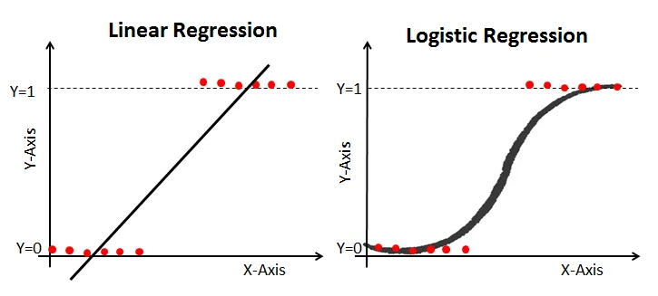
Regression

Slide 7
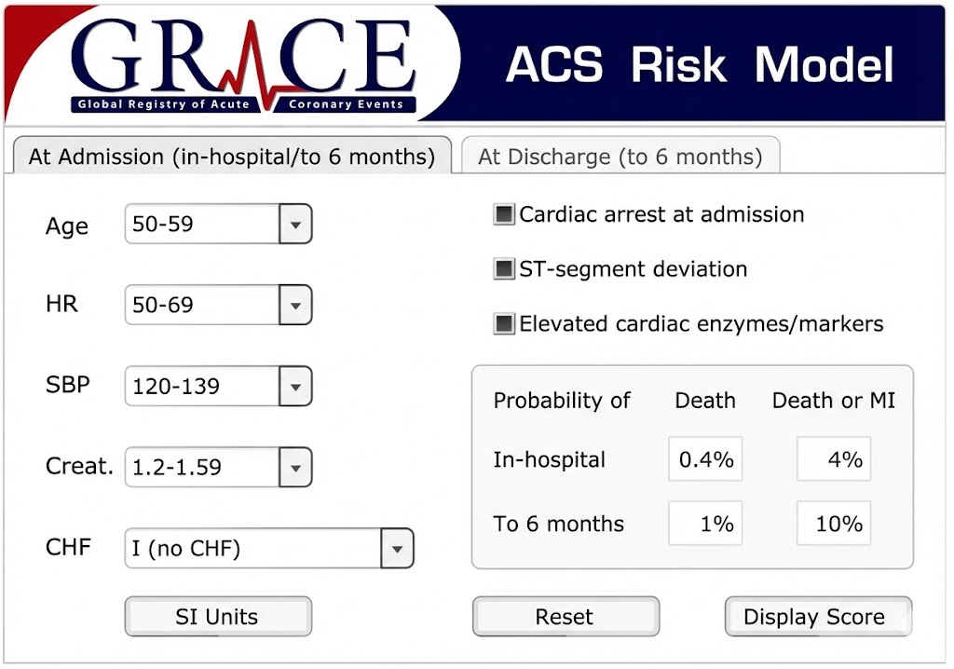

Slide 8
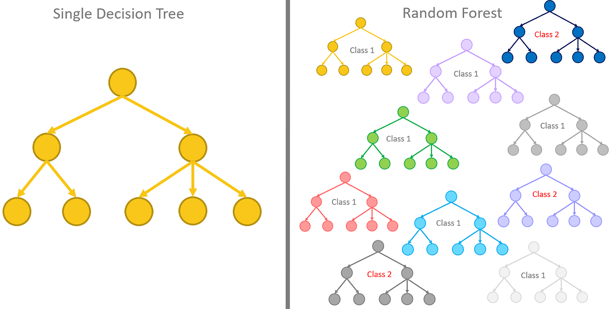
Tree-based

Slide 9
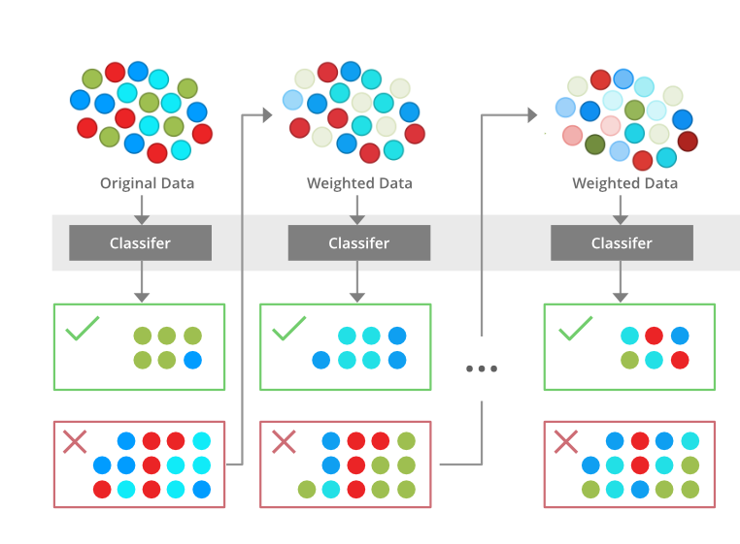
Tree-based

Slide 10
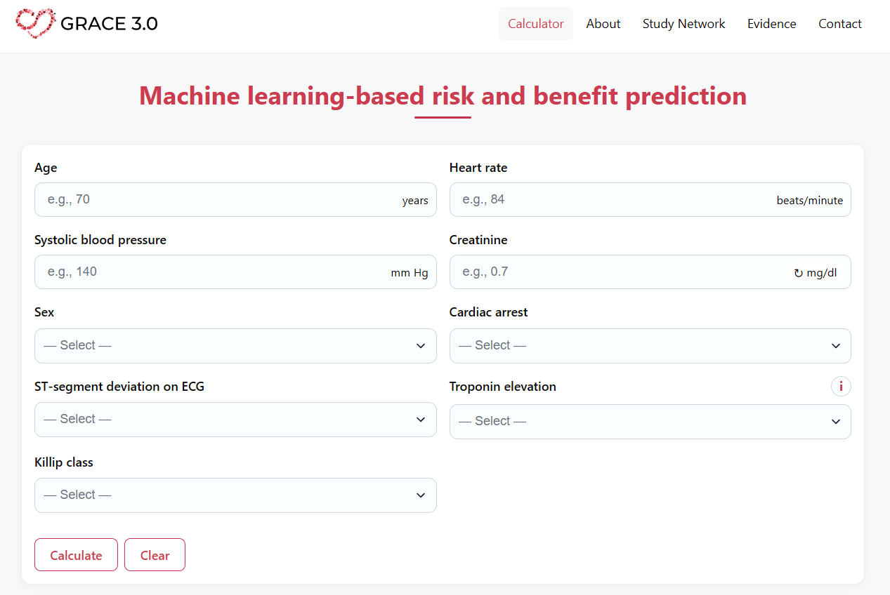

Slide 11
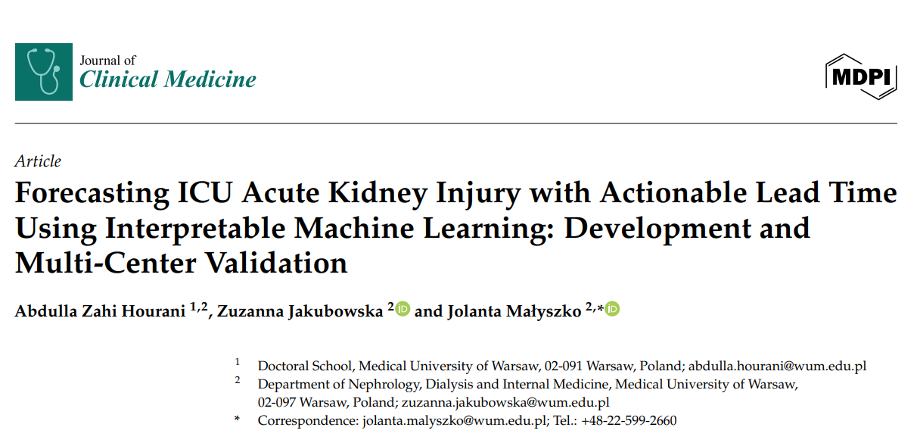

Slide 12
Creating ML models
- Choose the model based on your data size and data type.
- ML needs lots of examples to make reliable risk estimates.
- Use large, diverse data to reduce bias and improve generalization.
- Validate on an external cohort and test real-world impact (alerts, workload, cost).
- Keep outputs explainable so clinicians can trust and act on them.

Slide 13
Deep Learning
Computer vision
Signal processing
DL
Prediction tasks
Multimodality
Clustering

Slide 14
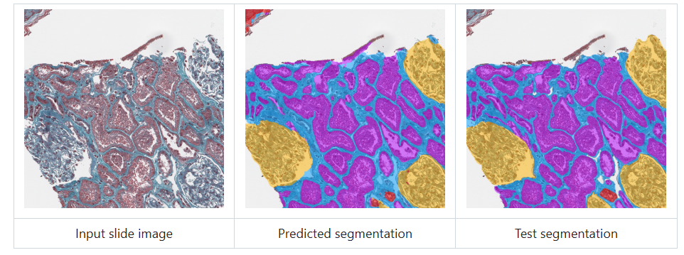
Computer vision

Slide 15
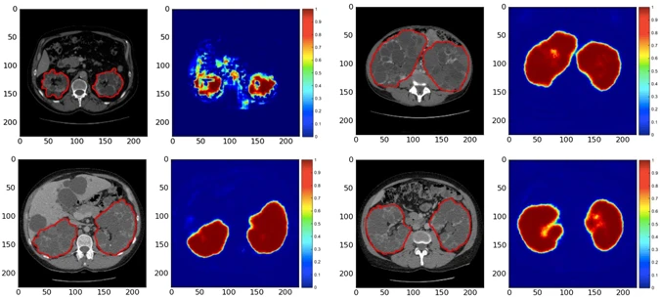
Computer vision

Slide 16
Clustering
Age
Sex
eGFR
Diabetes
Weight
Height

Slide 17
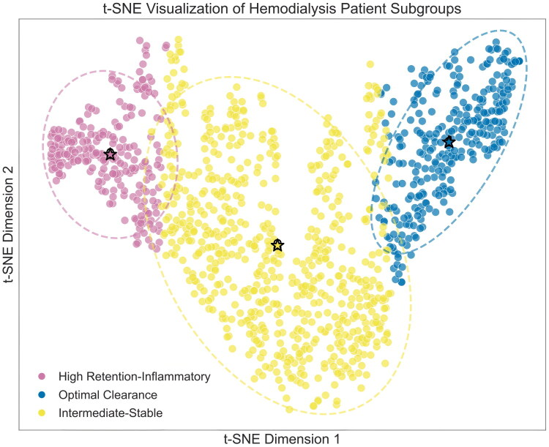
Clustering

Slide 18
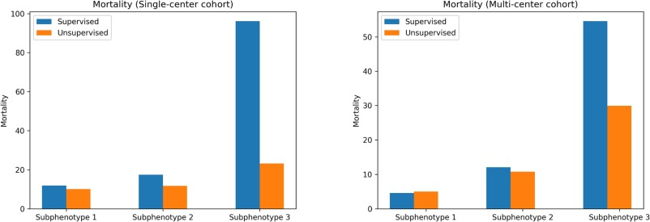
Clustering

Slide 19
Large Language Models
Extraction
Text generation
Multimodality
Clinical reasoning
LLM
Education

Slide 20
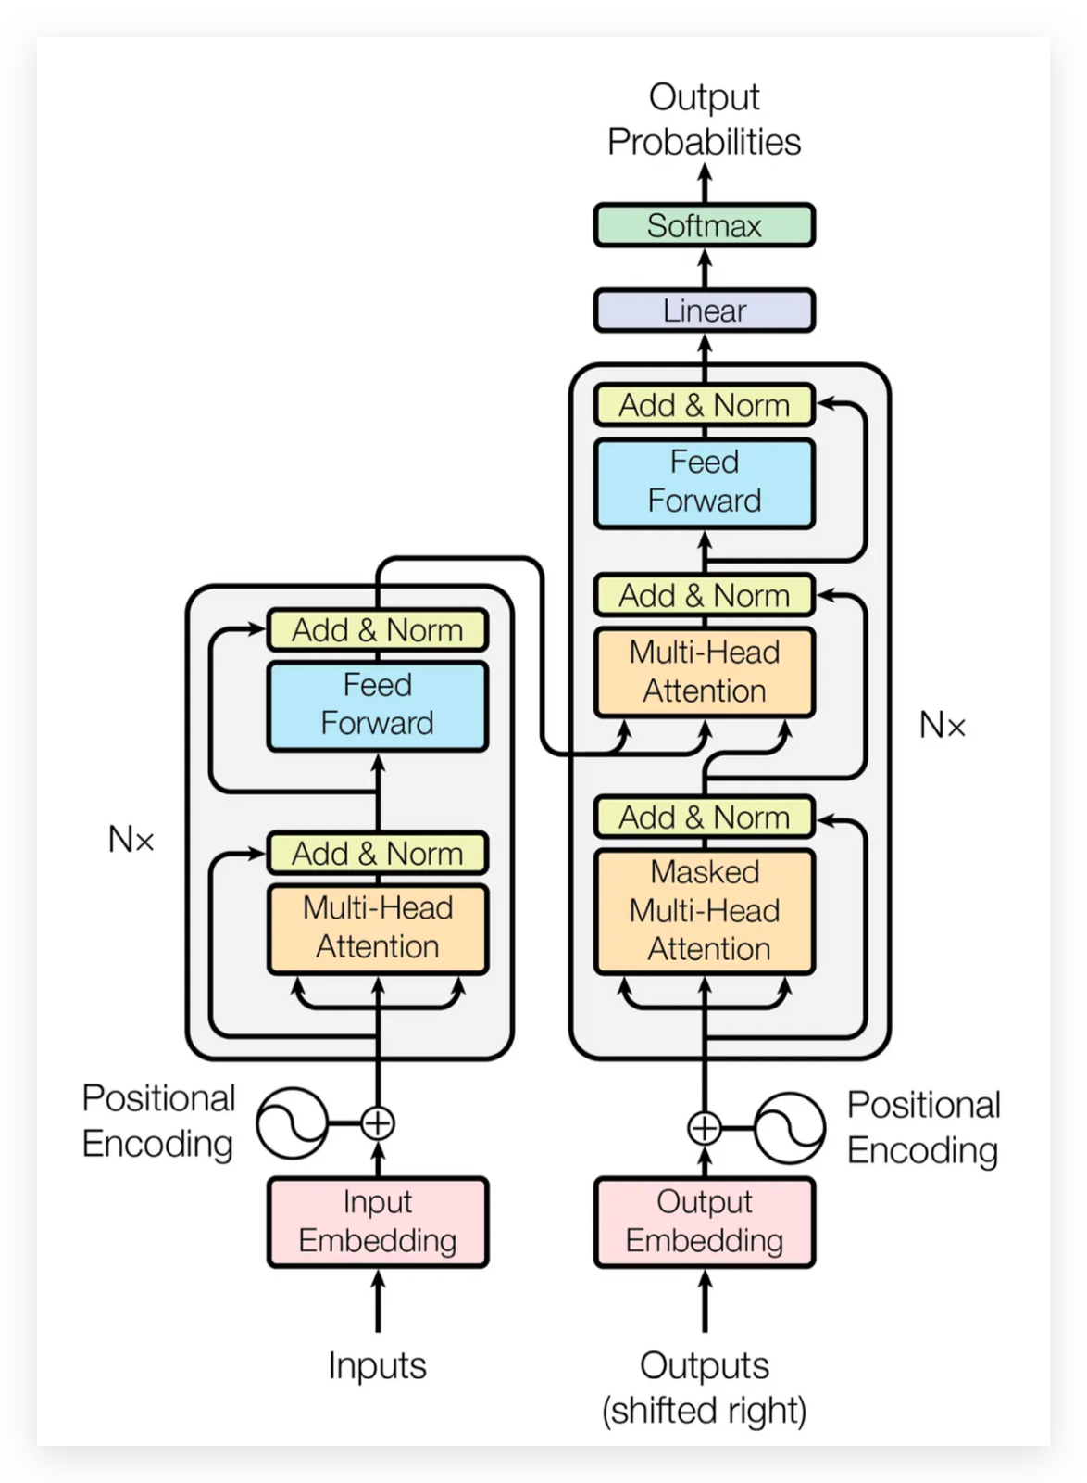


Slide 21
Extraction
Task: From the provided text, extract structured fields and output JSONL (1 line). Use null if missing. Set aki=1 if AKI/acute kidney injury or Cr rise mentioned; else 0. Set dialysis=1 only if dialysis/RRT/HD/CRRT mentioned; else 0.
Output (JSONL only):
{"name":<str|null>,"age":<int|null>,"sex":<"M"|"F"|null>,"allergies":<str|null>,"primary_diagnosis":<str|null>,"secondary_diagnoses":[<str>...],"aki":<0|1>,"dialysis":<0|1>,"administered_meds":[<str>...]}
{
"name": "…",
"age": 74,
"sex": "M",
"allergies": "No Known Allergies / Adverse Drug Reactions",
"primary_diagnosis": "Mechanical fall with head strike causing left intertrochanteric hip fracture",
"secondary_diagnoses": [
"Severe diastolic congestive heart failure (dCHF)",
"Chronic atrial fibrillation on warfarin",
"Coronary artery disease (CAD)",
"Chronic obstructive pulmonary disease (COPD)",
"Chronic kidney disease (baseline Cr ~1.2–1.4)",
"Flash pulmonary edema with hypoxemic respiratory failure (perioperative volume/FFP-related)",
"Acute on chronic kidney injury (Cr 1.3 → 3.3 mg/dL, recovered to ~1.2–1.3)",
"Anemia/blood loss (contributor to AKI)",
"Microscopic hematuria with mild proteinuria (no infection)",
"Electrolyte/acid-base abnormalities: hypokalemia, metabolic alkalosis, transient hyponatremia, phosphate initially high then low"
],
"aki": 1,
"dialysis": 0,
"administered_meds": [
"Diuresis/diuretics (aggressive; agent not specified in report)",
"Torsemide (continued at discharge)",
"Metolazone (held unless worsening overload)"
]
}
Name: …, Age: 74, Sex: M. Allergies: No Known Allergies / Adverse Drug Reactions. Report: Elderly man with severe diastolic CHF, chronic AF on warfarin, CAD/COPD, and baseline CKD (Cr ~1.2–1.4) was admitted after a mechanical fall with head strike causing a left intertrochanteric hip fracture. Surgery (L hip ORIF) was delayed/complicated by flash pulmonary edema and hypoxemic respiratory failure after perioperative volume/FFP; he required brief postoperative intubation and ICU care, then improved with aggressive diuresis but was discharged to rehab still needing ~4 L nasal oxygen.
Major nephrology finding was acute on chronic kidney injury: creatinine increased from 1.3 to 3.3 mg/dL (BUN up to 81) with oliguria, then down-trended to 1.2–1.3 by discharge. Suspected causes were multifactorial—renal hypoperfusion/over-diuresis, perioperative blood loss/anemia, and contrast exposure from CT. Urine studies showed very low urine sodium (11) and FeNa ~0.2%, supporting prerenal azotemia, though ATN was also considered; subsequent >2 L/day urine output suggested recovery/post-ATN diuresis. UA demonstrated large blood with ~33 RBC/hpf, mild proteinuria, and no evidence of infection, consistent with known longstanding microscopic hematuria. Electrolytes reflected diuretic effect (hypokalemia, metabolic alkalosis) with transient hyponatremia that resolved. Discharge plan emphasized continued torsemide, holding metolazone unless worsening overload, and repeat chemistry monitoring. Phosphate was initially elevated then low; monitor for repletion needs during rehabilitation and diuresis.

Slide 22
Extraction
From the dialysis-session narrative, extract ONLY the 10 key dialysis variables below and output ONLY valid JSON. Use null if missing.
{
"date": "YYYY-MM-DD|null", "modality": "string|null", "start_time": "HH:MM|null", "end_time": "HH:MM|null", "access": "string|null","Qb_mL_min": number|null,"dialysate_K_mEq_L": number|null, "net_UF_L": number|null, "intradialytic_complication": "string|null","K_pre_post": {"pre": number|null, "post": number|null, "units": "mmol/L"}
}
{
"date": "2026-02-11",
"modality": "Intermittent hemodialysis (IHD)",
"start_time": "09:07",
"end_time": "12:37",
"access": "Right internal jugular tunneled catheter",
"Qb_mL_min": 350,
"dialysate_K_mEq_L": 2.0,
"net_UF_L": 2.2,
"intradialytic_complication": "Symptomatic hypotension at 10:45 (BP 98/56) requiring UF reduction + NS bolus",
"K_pre_post": {
"pre": 5.9,
"post": 4.2,
"units": "mmol/L"
}
}
Report: the patient underwent intermittent hemodialysis for 3 hours 30 minutes due to AKI on CKD with volume overload and hyperkalemia. He arrived to the dialysis unit at 08:50 on 2 L/min nasal oxygen, alert and cooperative, reporting mild dyspnea when supine. Pre-dialysis vitals at 09:00 were BP 154/78 mmHg, HR 84 bpm (known AF), RR 18/min, SpO₂ 94% on 2 L NC, T 36.7°C. Pre-HD weight was 62.4 kg (estimated dry weight 60.0 kg). Dialysis was initiated at 09:07 via a right internal jugular tunneled catheter. Treatment was delivered using a high-flux dialyzer (1.8 m²) with blood flow 350 mL/min and dialysate flow 600 mL/min. The planned ultrafiltration goal was 2.5 L with an initial UF rate of ~800 mL/hr; anticoagulation was provided with heparin 1000 units bolus at initiation, then 500 units/hour, stopped 30 minutes prior to completion.. By 10:55, symptoms resolved and BP improved to 118/64 without further recurrence. The remainder of the session proceeded uneventfully with continued gradual fluid removal. Dialysis was completed at 12:37 with net UF 2.2 L, post-HD weight 60.2 kg, and end-of-treatment vitals of BP 136/70, HR 80, RR 16, SpO₂ 96% on 1–2 L NC. Laboratory response was appropriate: pre-HD (08:30) values included K 5.9 mmol/L, HCO₃ 18 mmol/L, BUN 78 mg/dL, creatinine 4.1 mg/dL, phosphate 6.2 mg/dL, calcium 8.1 mg/dL, and Hgb 8.2 g/dL; post-HD (13:15) showed K 4.2 mmol/L, HCO₃ 24 mmol/L, BUN 32 mg/dL, creatinine 3.5 mg/dL, phosphate 3.9 mg/dL, consistent with adequate solute clearance and correction of hyperkalemia and acidosis.

Slide 23
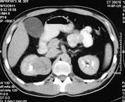
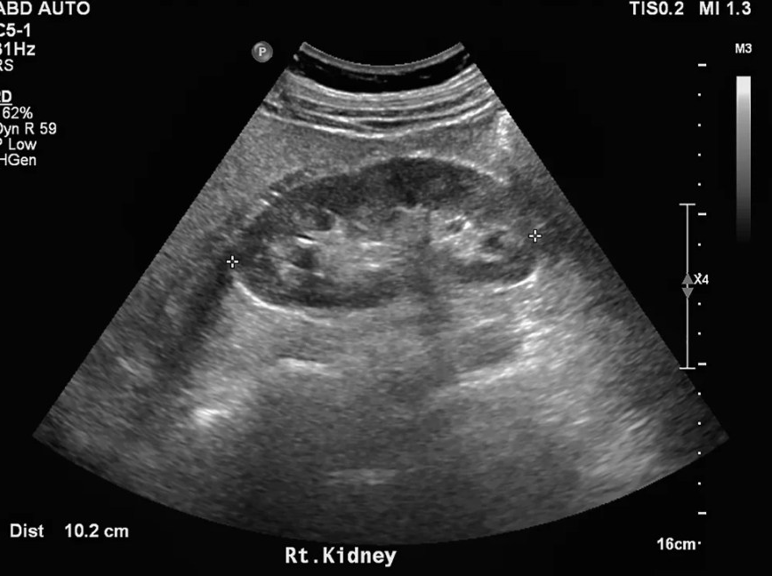
Text Generation
na: 139 mmol/L; 2026-02-01
wt: 72.4 kg; 2026-02-01
bp: 154/78 mmHg; 2026-02-01 09:00
hr: 84 bpm; 2026-02-01 09:00
spo2: 94 %; 2026-02-01 09:00
k: 5.9 mmol/L; 2026-02-01 08:30
hco3: 18 mmol/L; 2026-02-01 08:30
bun: 78 mg/dL; 2026-02-01 08:30
creat: 6.2 mg/dL; 2026-02-01 08:30
k: 4.4 mmol/L; 2026-02-01 13:15
bp: 98/56 mmHg; 2026-02-01 10:45
na: 138 mmol/L; 2026-02-02
wt: 71.8 kg; 2026-02-02
bp: 148/80 mmHg; 2026-02-02 08:10
spo2: 92 %; 2026-02-02 08:10
k: 5.2 mmol/L; 2026-02-02 07:50
k: 5.3 mmol/L; 2026-02-02 18:00
hco3: 20 mmol/L; 2026-02-02 07:50
hgb: 7.9 g/dL; 2026-02-02 07:50
rr: 18 /min; 2026-02-02 08:10
temp: 36.8 C; 2026-02-02 08:10
na: 137 mmol/L; 2026-02-03
wt: 70.6 kg; 2026-02-03
bp: 152/85 mmHg; 2026-02-03 09:10
hr: 91 bpm; 2026-02-03 09:10
spo2: 92 %; 2026-02-03 09:10
k: 5.6 mmol/L; 2026-02-03 06:2
Admission Reason: Right flank pain, fever, dysuria, and rising creatinine concerning for complicated urinary tract infection/pyelonephritis with acute kidney injury (AKI). Discharge Diagnoses: Acute right-sided pyelonephritis (complicated UTI) AKI, prerenal/acute tubular injury on infection/dehydration — resolved/improving Mild dehydration Hospital Course: The patient presented with fever (up to 38.8°C), right costovertebral angle tenderness, leukocytosis, and elevated inflammatory markers. Initial serum creatinine was 1.9 mg/dL (baseline ~1.0 mg/dL). Urinalysis showed pyuria, positive leukocyte esterase, and bacteriuria. The patient received IV fluids and empiric IV antibiotics (ceftriaxone). Renal ultrasound demonstrated no hydronephrosis. Contrast-enhanced CT abdomen showed striated nephrogram and mild perinephric stranding of the right kidney without abscess or obstruction, consistent with acute pyelonephritis. Blood cultures remained negative. Urine culture grew E. coli, susceptible to ceftriaxone and ciprofloxacin; antibiotics were narrowed and transitioned to oral therapy once afebrile and tolerating diet. Kidney function improved with hydration and infection control (creatinine down to 1.2 mg/dL by discharge). Pain controlled with acetaminophen; NSAIDs avoided. Condition at Discharge: Afebrile, hemodynamically stable, improved flank pain, adequate oral intake, good urine output. Discharge Medications: Oral antibiotic to complete total course acetaminophen PRN, home meds resumed except nephrotoxins. Follow-up / Instructions: Primary care or nephrology follow-up in 1–2 weeks.
Clinical history/Indication: Fever and right flank pain. Evaluate for pyelonephritis vs obstruction. Technique: Helical CT of the abdomen following IV contrast administration. Axial images reviewed with multiplanar reformats. Right kidney: Mildly enlarged with heterogeneous/striated enhancement and subtle wedge-shaped hypoenhancing regions. Mild perinephric fat stranding. No rim-enhancing collection to suggest abscess. No hydronephrosis. No definite obstructing ureteral calculus seen on the provided level. Left kidney: Preserved enhancement. No hydronephrosis. Collecting systems/ureters: No hydroureter on the provided level. Other visualized upper abdominal structures: No acute abnormality on the provided image.
CT appearance most consistent with acute right-sided pyelonephritis (striated nephrogram with mild perinephric stranding). No hydronephrosis and no CT evidence of renal/perinephric abscess on the provided level.
Discharge report
Report summarisation
Clinical history/Indication: Right flank pain / AKI. Rule out obstruction. Technique: Grayscale and color Doppler evaluation of the kidneys (right kidney shown). Right kidney: Measures approximately 12.2 cm in length. Heterogeneous renal parenchymal echotexture with mildly reduced corticomedullary differentiation. No hydronephrosis. No definite shadowing calculus is identified on the provided image. Color Doppler shows preserved perfusion (limited single-image assessment). Left kidney / bladder: Not assessed on the provided image.No hydronephrosis (no sonographic evidence of obstructive uropathy on the provided view). Nonspecific heterogeneous right renal parenchyma, which can be seen with acute pyelonephritis (in the appropriate clinical setting) or medical renal disease. Correlate with urinalysis and inflammatory markers; consider contrast CT if concern for complicated infection or discordant clinical course.

Slide 24
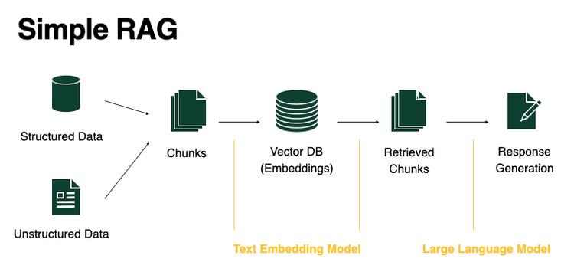
Education

Slide 25
Education
Question:
“How do I classify albuminuria from UACR 120 mg/g?”
RAG:
KDIGO GL issue x, page x:
Albuminuria categories (UACR):
A1: <30 mg/g
A2: 30–300 mg/g
A3: >300 mg/g
Answer:
A2 (moderately increased albuminuria).
UACR 120 mg/g falls in 30–300 mg/g. The current categorisation as per the latest KDIGO GL is:
A1: <30 mg/g
A2: 30–300 mg/g
A3: >300 mg/g

Slide 26
Clinical Reasoning
Question:
62M, T2D + CKD G3b (eGFR 28), UACR 420 mg/g, BP 148/86, K 4.7.
Currently on lisinopril 10 mg only (not at max dose).
Per KDIGO, what kidney-protective therapy should be optimized/added (ACEi/ARB, SGLT2i, finerenone), and what monitoring/stop rules apply?
CoT:
Likely: ACEi/ARB for HTN + albuminuria → titrate up
Add SGLT2i if eGFR ≥30? (not sure on threshold)
Finerenone maybe helps albuminuria, but unclear eGFR/K cutoffs
Need guidance to avoid outdated thresholds + to apply graded recommendations
CoT:
Patient qualifies for SGLT2i now because eGFR 28 ≥20 (1A)
Must optimize ACEi/ARB first (already on low-dose lisinopril; titrate to max tolerated)
Finerenone is next-step if albuminuria persists despite max RASi, since eGFR ≥25 and K is normal
Monitoring anchors: check creatinine + K after RASi titration; watch for hyperkalemia/creatinine rise; withhold SGLT2i during acute illness/surgery-type settings
RAG:
RAS blockade:Recommendation 1.2.1 (1B) — initiate ACEi/ARB in diabetes + HTN + albuminuria and titrate to highest tolerated dose; monitor BP/creatinine/K after initiation or dose changes. SGLT2 inhibitor (verbatim graded line): “We recommend treating patients with type 2 diabetes (T2D), CKD, and an eGFR ≥20 ml/min per 1.73 m² with an SGLT2i (1A).” ns-MRA (finerenone):Recommendation 1.4.1 (2A) — consider if eGFR ≥25, normal K, and albuminuria persists despite max tolerated RASi.
Answer:
Up-titrate lisinopril (or ARB) to max tolerated (KDIGO 1B); recheck BP, creatinine, K after dose changes.
Start an SGLT2 inhibitor now (KDIGO 1A, eGFR ≥20).
Add finerenone if albuminuria remains high despite max RASi and K stays normal (KDIGO 2A; eGFR ≥25)

Slide 27
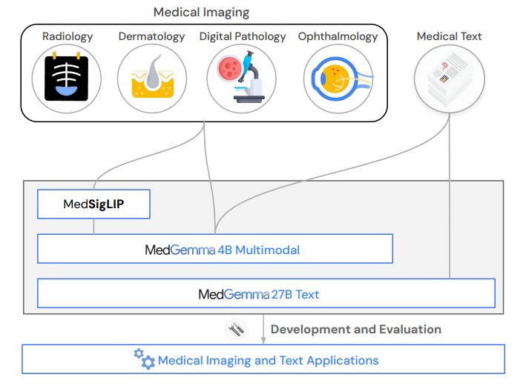
Clinical LLMs

Slide 28
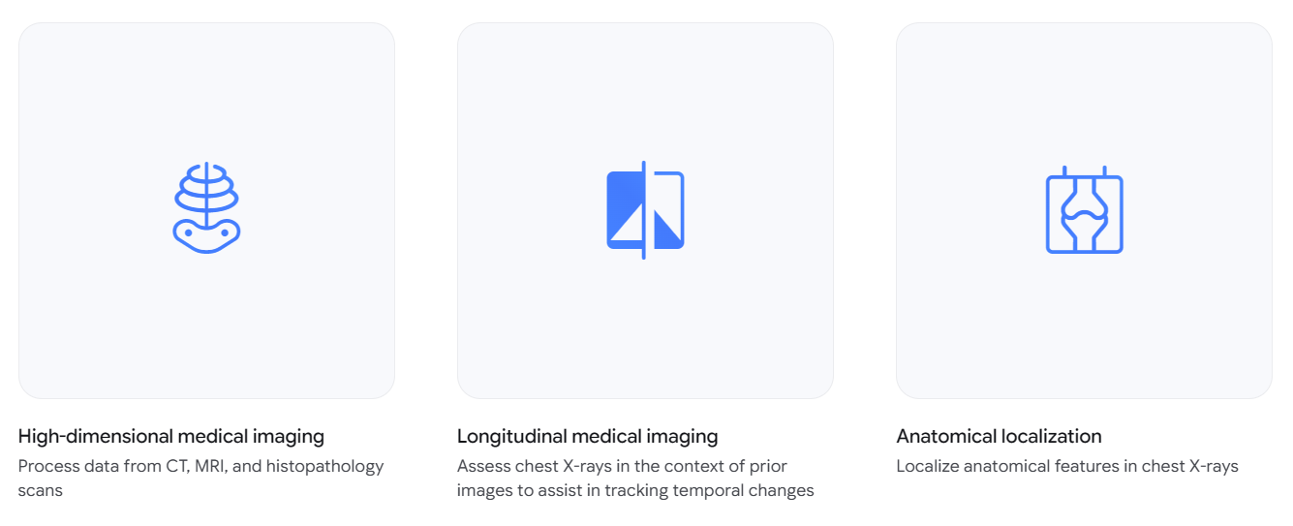
Clinical LLMs

Slide 29
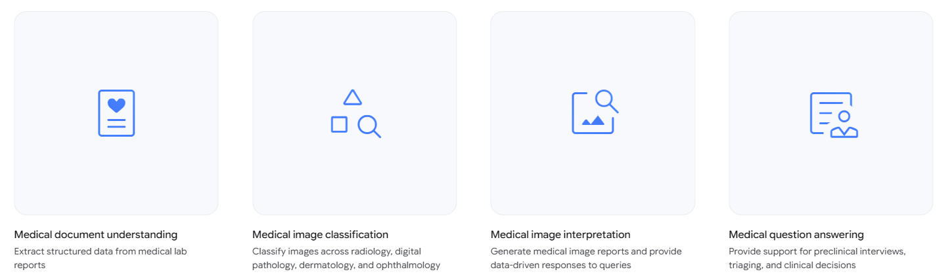
Clinical LLMs

Slide 30
With all these advancements, can AI systems still hallucinate?

Slide 31
Yes! They do

Slide 32
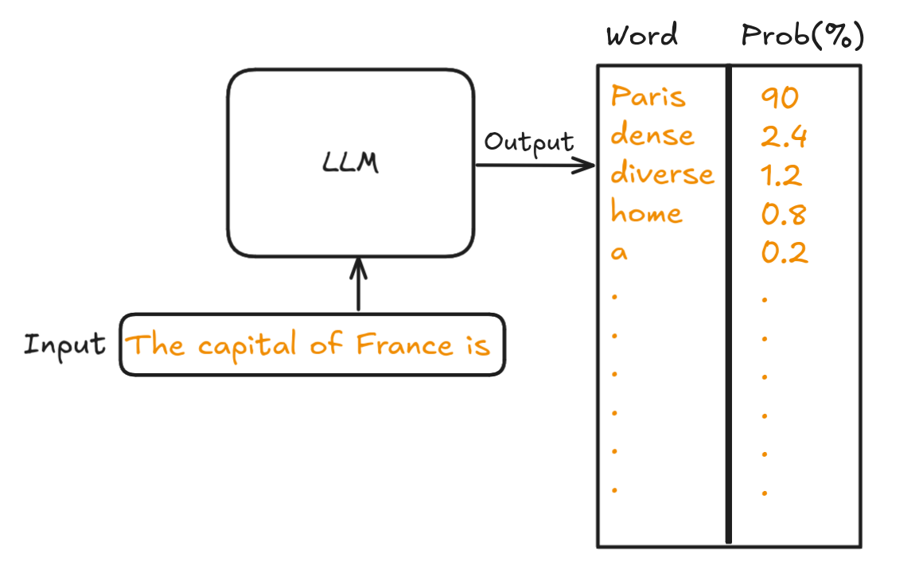
How do LLMs work?

Slide 33
How do LLMs work?
The correct answer is:
✅ Extracapillary proliferation and segmental necrosis
Why?
This patient has features concerning for Rapidly Progressive Glomerulonephritis (RPGN):
Rapid rise in creatinine (1.2 → 3.2 mg/dL)
Hematuria (1+ blood)
Proteinuria (2+ protein)
Edema
Hypertension
RPGN is a clinical syndrome, not a specific disease, characterized by rapid loss of kidney function over weeks to months.
Key Histologic Feature on Light Microscopy
The hallmark of RPGN on light microscopy is:
Crescent formation due to extracapillary proliferation
This occurs because:
Severe glomerular injury causes leakage of fibrin into Bowman’s space
Parietal epithelial cells proliferate
Macrophages infiltrate
Leads to crescent-shaped lesions
This corresponds to:
➡️ Extracapillary proliferation and segmental necrosis
Why the Other Options Are Incorrect
Linear deposits along the GBM
→ Seen in anti-GBM disease (Goodpasture) on immunofluorescence, not light microscopy.
Granular deposits of immunoglobulins
→ Seen in immune complex diseases (e.g., lupus nephritis, post-strep GN) on immunofluorescence.
Normal glomeruli with no inflammation
→ Seen in minimal change disease (nephrotic syndrome), not RPGN.
Summary
RPGN =
🧪 Rapid renal decline
🩸 Hematuria + proteinuria
🔬 Light microscopy → Crescents (extracapillary proliferation + necrosis)
Final Answer:
Extracapillary proliferation and segmental necrosis
Answer the question below.
{"question": "A 74-year-old woman presents to her PCP with a 6-week history of fatigue, decreased appetite, and weight loss. On examination, her BP is 164/98 mm Hg. She has 1+ lower limb edema. Her laboratory testing is notable for serum creatinine 3.2 mg/dl, from a prior baseline of 1.2 mg/dl. Her UA shows 2+ protein and 1+ blood. What is a common histologic feature of RPGN you would expect to find on light microscopy?"
"options": [
A- Linear deposits along the glomerular basement membrane,
B- Granular deposits of immunoglobulins
C- Extracapillary proliferation and segmental necrosis
D- Normal glomeruli with no inflammation
]

Slide 34
How do LLMs work?
The clinical presentation (acute rise in creatinine over weeks with proteinuria, hematuria, hypertension, edema) suggests a rapidly progressive glomerulonephritis (RPGN).
Correct answer:
✔️ Extracapillary proliferation and segmental necrosis
Explanation:
On light microscopy in RPGN, the hallmark lesion is crescent formation—which represents extracapillary proliferation of parietal epithelial cells and inflammatory cells within Bowman's space. These crescents often accompany segmental necrosis of glomerular tufts. This pattern reflects severe glomerular injury and underlies the rapidly progressive clinical course.
The other options correlate with different diseases:
Linear deposits along the GBM → seen in anti-GBM disease on immunofluorescence, not a light microscopy pattern.
Granular immunoglobulin deposits → typical of immune-complex GN (e.g., post-infectious) on immunofluorescence/electron microscopy.
Normal glomeruli → would not explain the acute kidney injury and urinary abnormalities.
So the key histologic feature for RPGN is extracapillary (crescentic) proliferation with segmental necrosis.
You are an experienced nephrology specialist. Read the question below and answer it as per the latest guidelines.
{"question": "A 74-year-old woman presents to her PCP with a 6-week history of fatigue, decreased appetite, and weight loss. On examination, her BP is 164/98 mm Hg. She has 1+ lower limb edema. Her laboratory testing is notable for serum creatinine 3.2 mg/dl, from a prior baseline of 1.2 mg/dl. Her UA shows 2+ protein and 1+ blood. What is a common histologic feature of RPGN you would expect to find on light microscopy?"
"options": [
A- Linear deposits along the glomerular basement membrane,
B- Granular deposits of immunoglobulins
C- Extracapillary proliferation and segmental necrosis
D- Normal glomeruli with no inflammation
]

Slide 35
How do LLMs work?
The correct answer is:
Extracapillary proliferation and segmental necrosis
Clinical reasoning
This 74-year-old woman presents with:
Subacute kidney injury (Cr 1.2 → 3.2 mg/dL in 6 weeks)
Hypertension
Edema
Hematuria + proteinuria
This clinical picture is highly suggestive of rapidly progressive glomerulonephritis (RPGN) — a nephritic syndrome characterized by rapid loss of renal function over weeks to months.
What is RPGN?
RPGN is a clinical syndrome, not a single disease. The defining histologic lesion is:
Crescent formation in glomeruli
Key Light Microscopy Finding
Crescentic Glomerulonephritis
On light microscopy, you typically see:
Extracapillary proliferation
Crescents in Bowman’s space
Segmental necrosis of glomerular capillary loops
Crescents are formed by:
Proliferation of parietal epithelial cells
Infiltration of macrophages
Fibrin leakage into Bowman’s space
This is the hallmark of RPGN.
Why the Other Options Are Incorrect
Linear deposits along the GBM
→ Seen in anti-GBM disease (Goodpasture) on immunofluorescence, not light microscopy.
Granular deposits of immunoglobulins
→ Seen in immune complex GN (e.g., lupus nephritis, post-infectious GN), detected on immunofluorescence, not standard light microscopy.
Normal glomeruli with no inflammation
→ Seen in minimal change disease — not consistent with nephritic syndrome or RPGN.
Important Guideline Perspective (KDIGO 2021 GN Guidelines)
Kidney Disease: Improving Global Outcomes (KDIGO) defines crescentic GN as:
≥50% of glomeruli containing crescents
Rapid decline in kidney function
Often associated with ANCA, anti-GBM, or immune complex disease
Final Answer:
Extracapillary proliferation and segmental necrosis
You are an experienced nephrology specialist. Read the question below and please answer it as per the latest guidelines.
{"question": "A 74-year-old woman presents to her PCP with a 6-week history of fatigue, decreased appetite, and weight loss. On examination, her BP is 164/98 mm Hg. She has 1+ lower limb edema. Her laboratory testing is notable for serum creatinine 3.2 mg/dl, from a prior baseline of 1.2 mg/dl. Her UA shows 2+ protein and 1+ blood. What is a common histologic feature of RPGN you would expect to find on light microscopy?"
"options": [
A- Linear deposits along the glomerular basement membrane,
B- Granular deposits of immunoglobulins
C- Extracapillary proliferation and segmental necrosis
D- Normal glomeruli with no inflammation
]

Slide 36
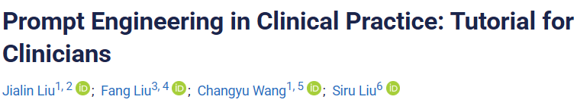
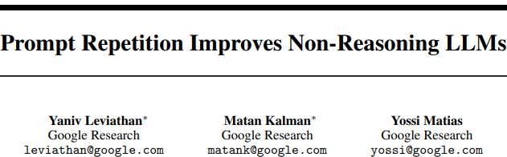
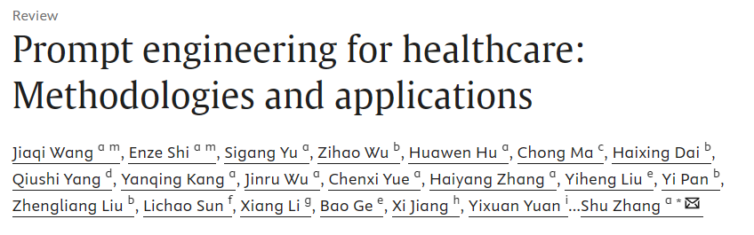
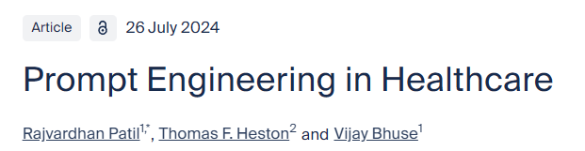


Slide 37
Which LLMs to choose?
Modality
Complexity
Language
Sample size
Task type
Data privacy

Slide 38
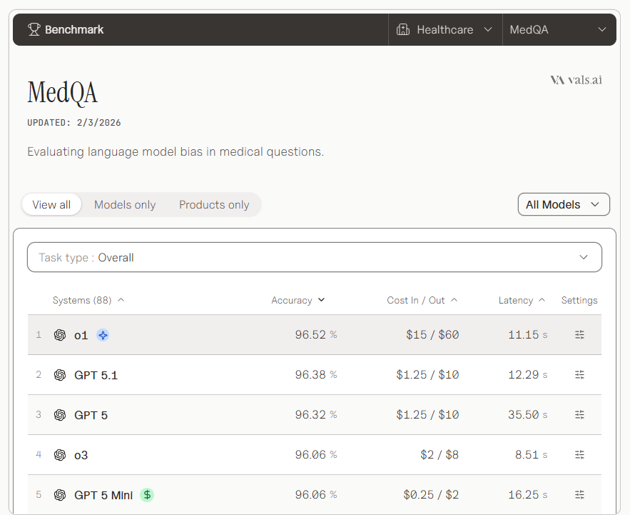
Which LLMs to choose?
https://www.vals.ai

Slide 39
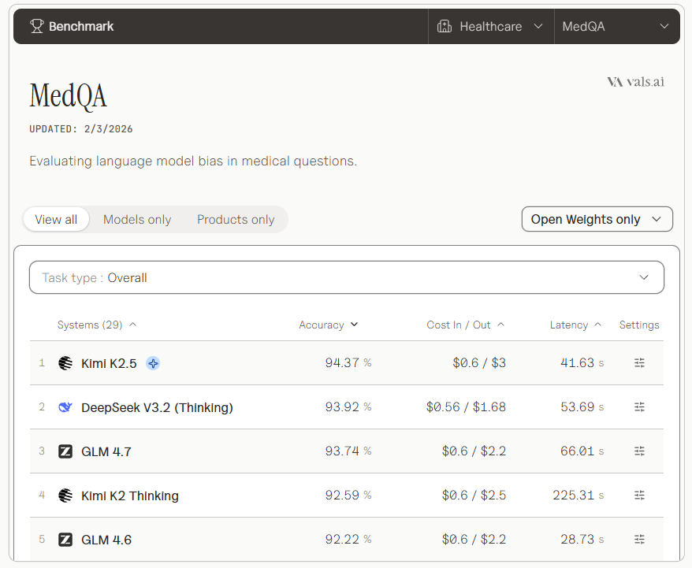
Which LLMs to choose?

Slide 40
Agents
Clinical support
Systems
Automation
Agents
LLM

Slide 41
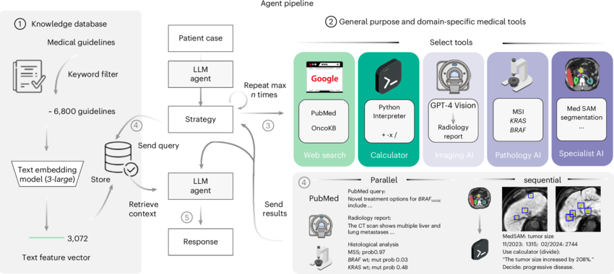
Clinical agents

Slide 42
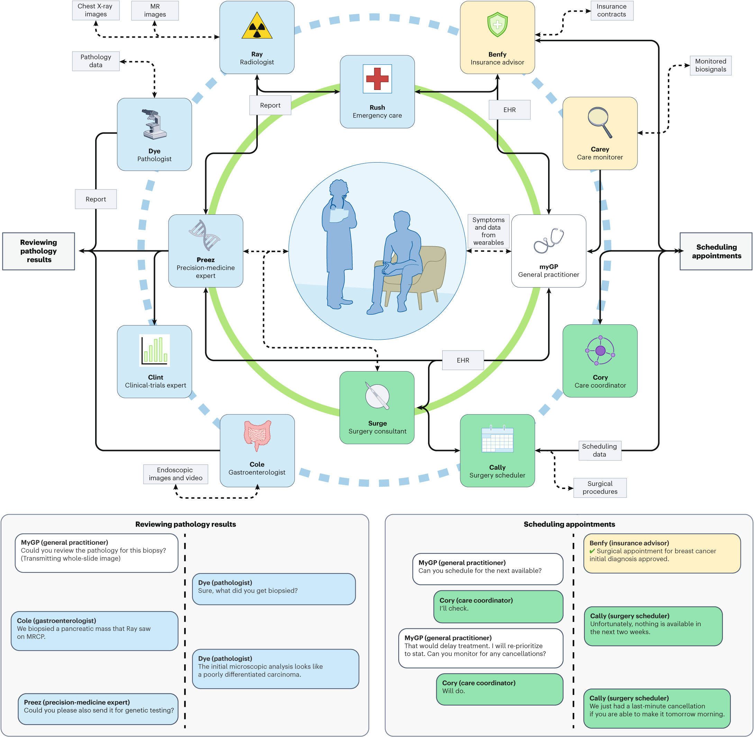
Systems

Slide 43
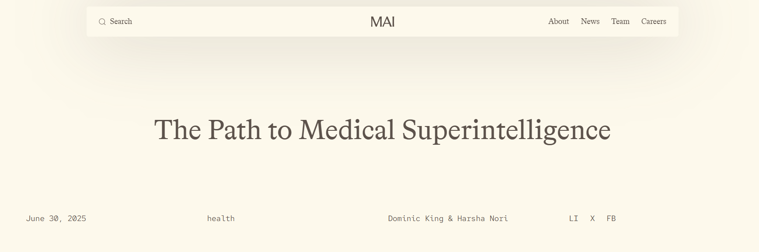
Systems

Slide 44
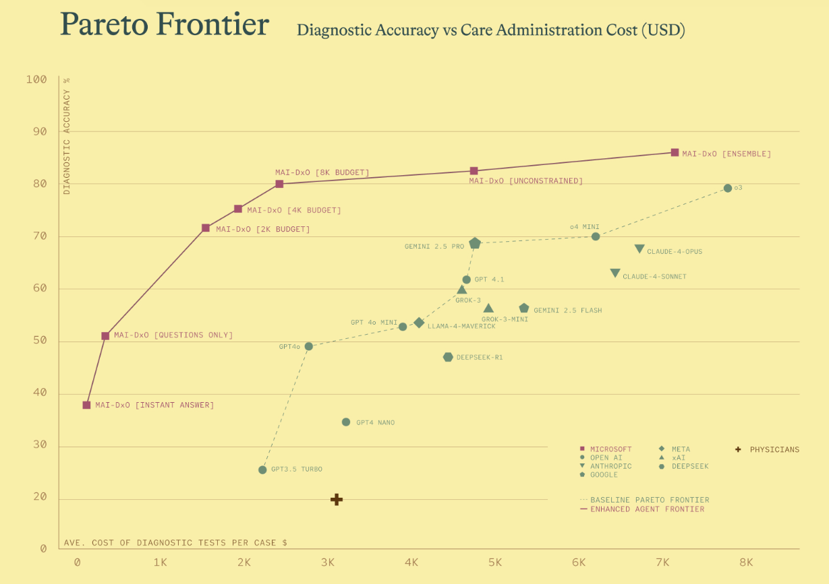

Slide 45
Final Remarks

Slide 46

Thank You!
www.abdullahourani.com
Dr. Abdulla Hourani
Supervisors: Prof Dr. Jolanta Malyszko; Dr. Zuzanna Jakubowska

